Slide 1
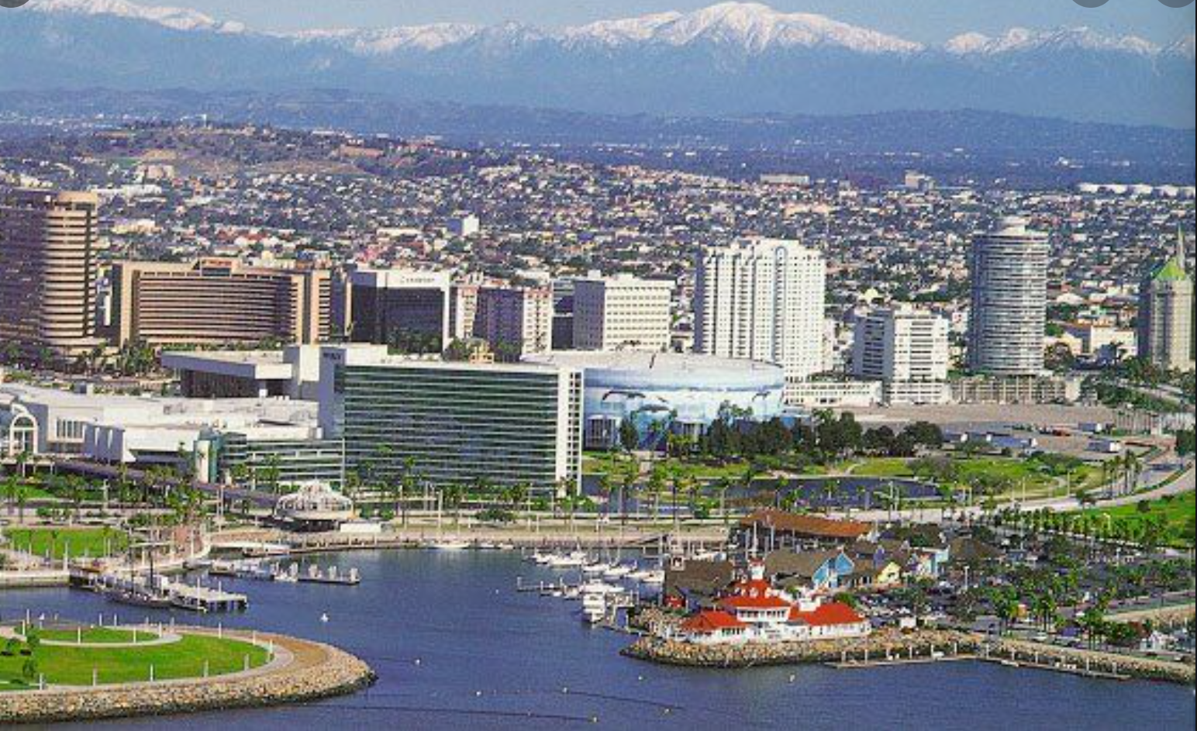

How Did the COVID-Pandemic Impact Water Usage in Long Beach, CA?
By: Ensieh Bahrami
Data Science Intensive Capstone Project

Slide 2
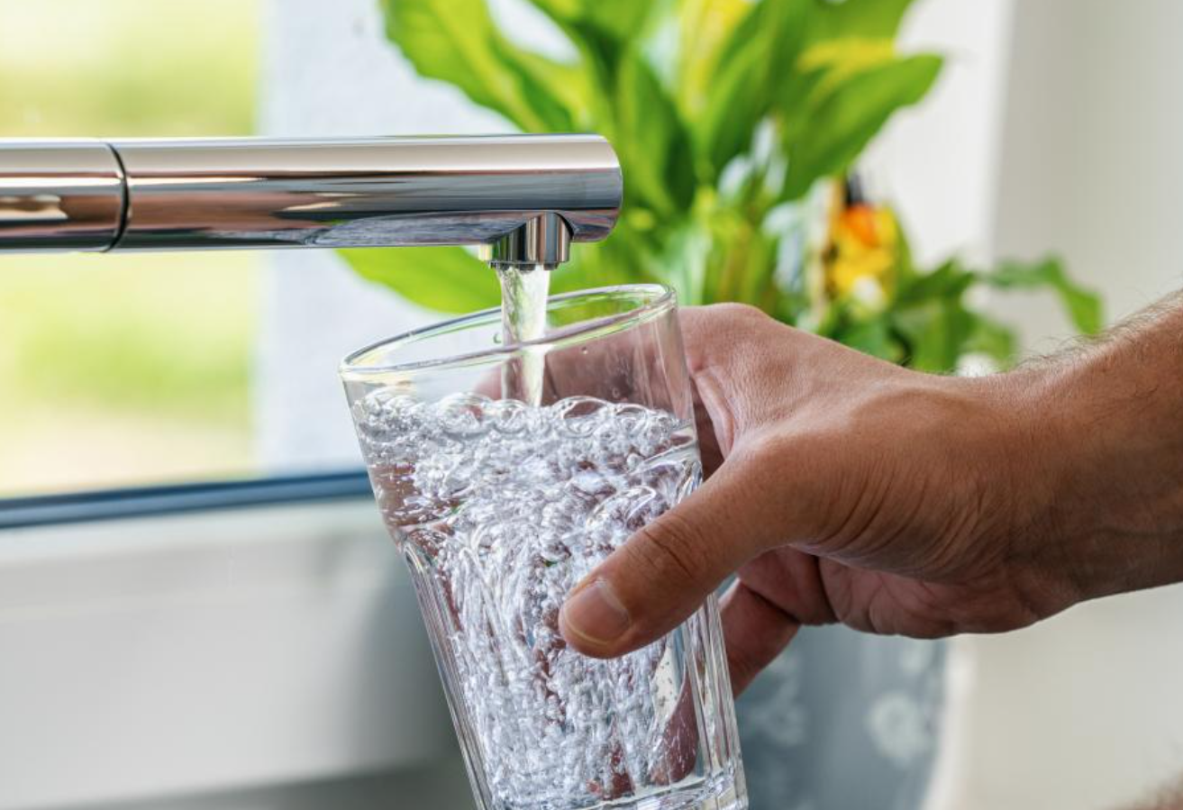

The Problem
Water usage by 6 type of customers within three years (2017 - 2020)
Pick daily usage:
June, July, August
Did COVID-Pandemic affect water usage?
What factors affects water consumption?
Can I predict water usage during the pandemic?

Slide 3

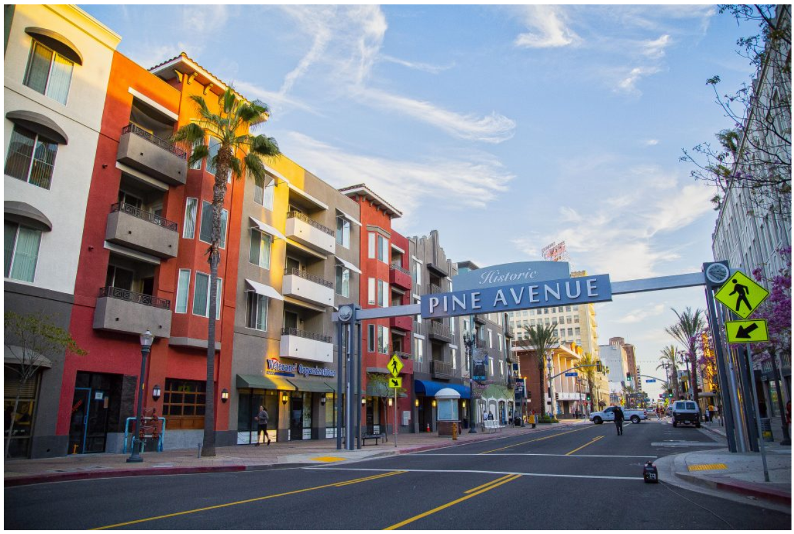


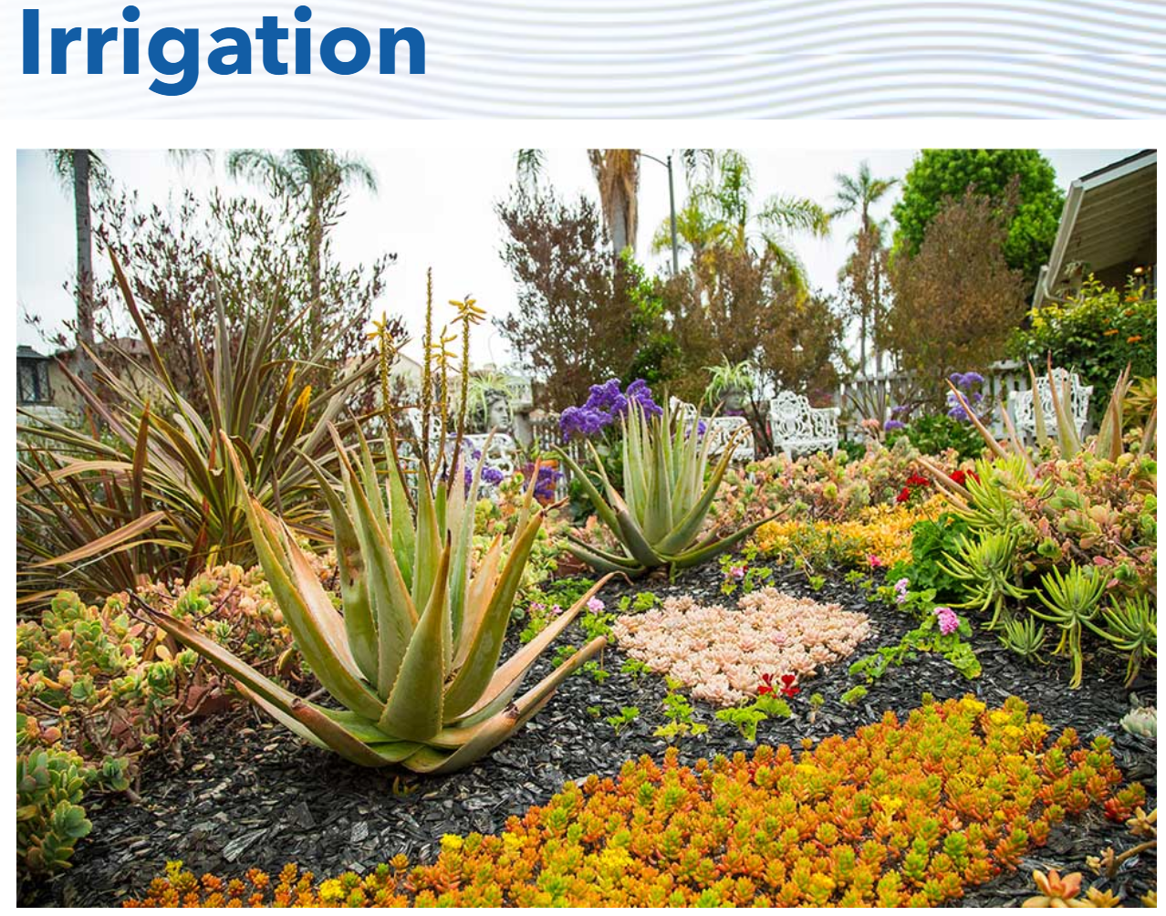
Who might care?
Water Department
Find effective ways to provide reliable water supply
Customers
Mange their usage and save on water bills
Government
Effectively allocate budget to provide the required Facilities and contribute into economy growth
Notes:
Observing and predicting water usage, help water department find effective ways to provide reliable water supply
Informing customers from the average usage of their group help them to manage their usage

Slide 4
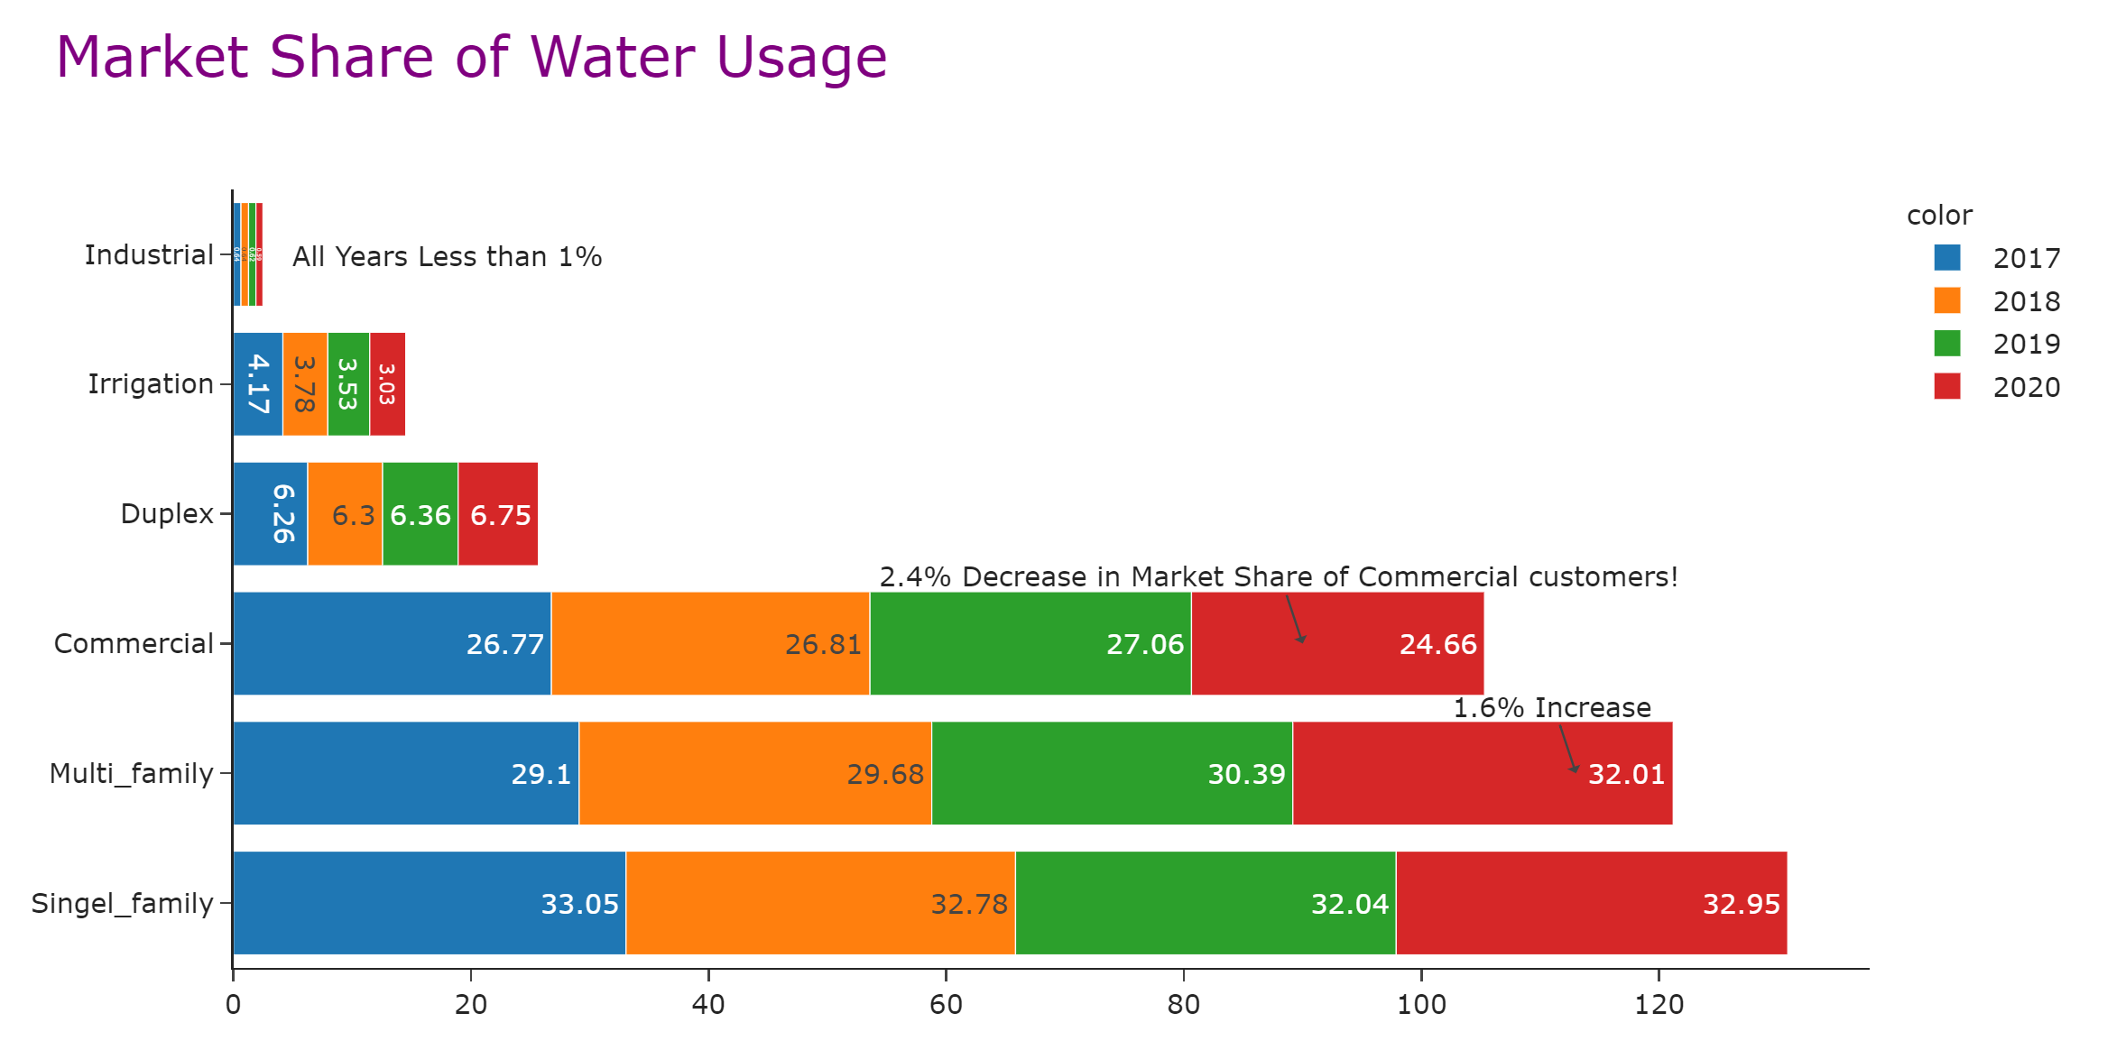
Approximately 80,000 customers

Slide 5
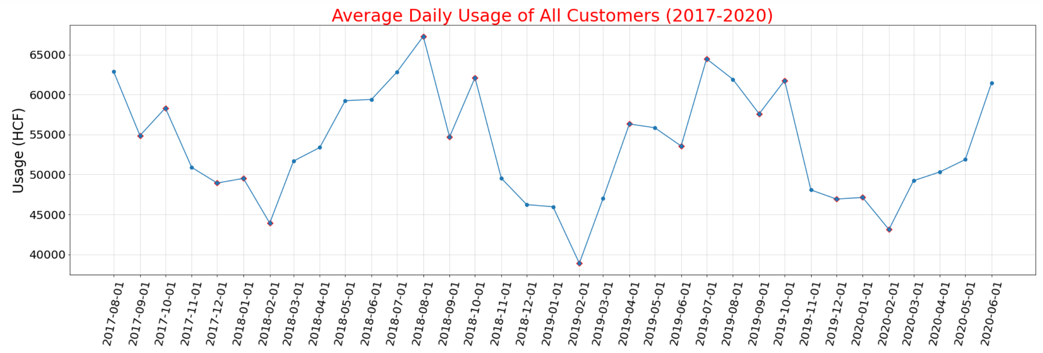
Change in Trend and Seasonality from March 2020
Feb 2020 was 29 days
Decrease in usage from March 2020 and continue until June compared with months in previous years
Notes:
Average daily usage in Feb 2018,2019 and 2020 were the minimum. The reason might be related to number of days in Feb (Feb 2017,2018,2019 had 28 days and Feb2020 had 29 days).
June and July demonstrate the relatively high usage in years of 2017,2018 and 2019, the increase in water consumption is due to summer season. Also, Nov, Dec and Feb show decrease in usage,so there is a seasonality.
In 2020, water usage decreased from March 2020 and continue until June compared with similar months inprevious years.
Besides seasonality, there is a trend that seems it is not kept in 2020.

Slide 6
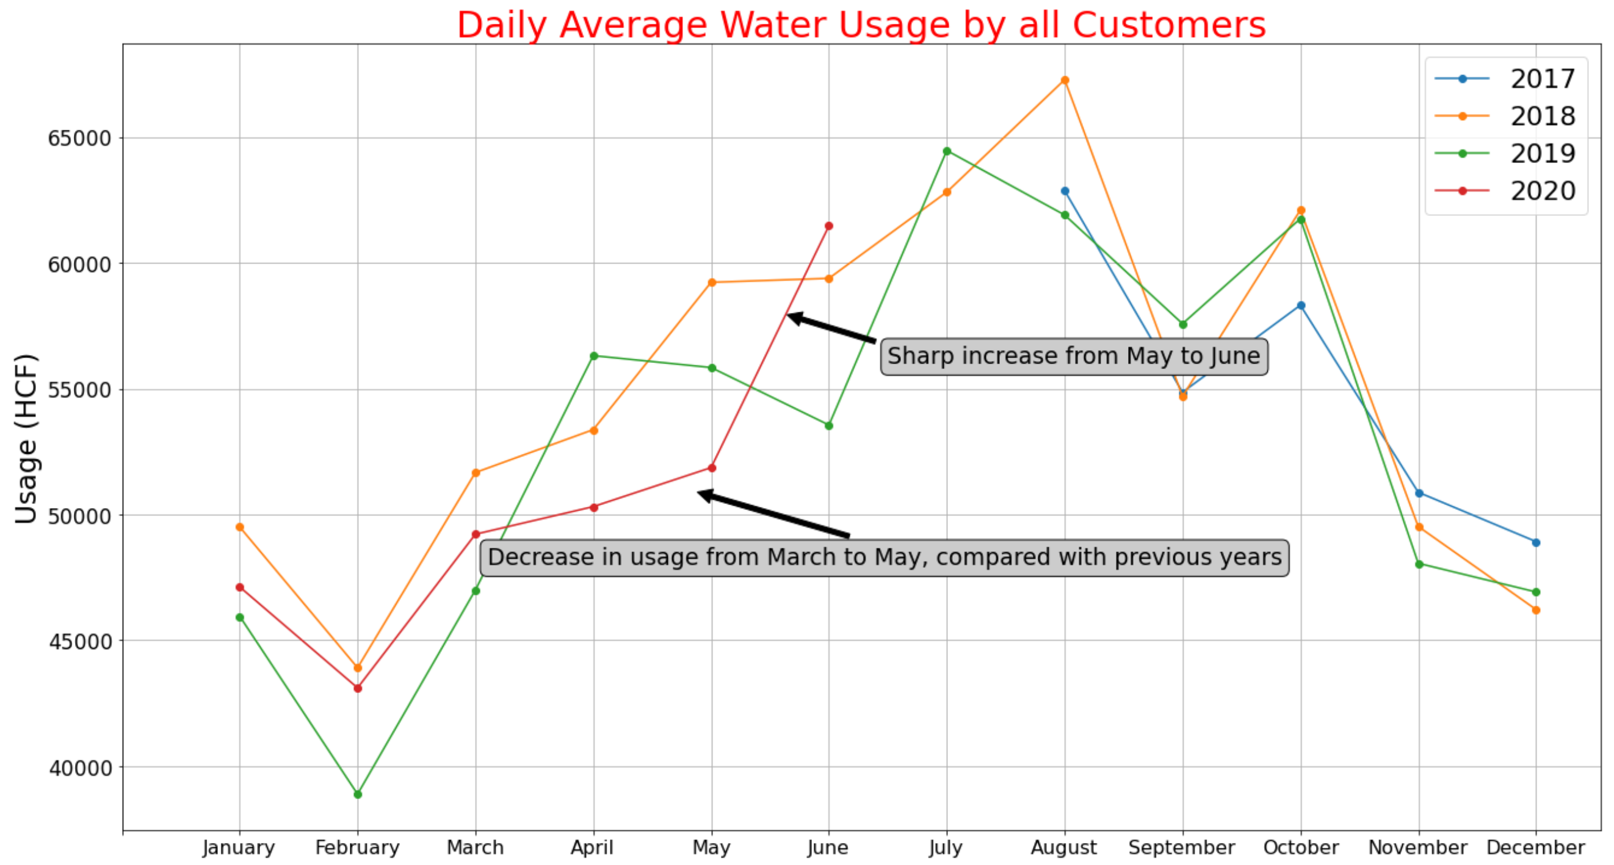
What Segments had more role in a different trend?

Slide 7
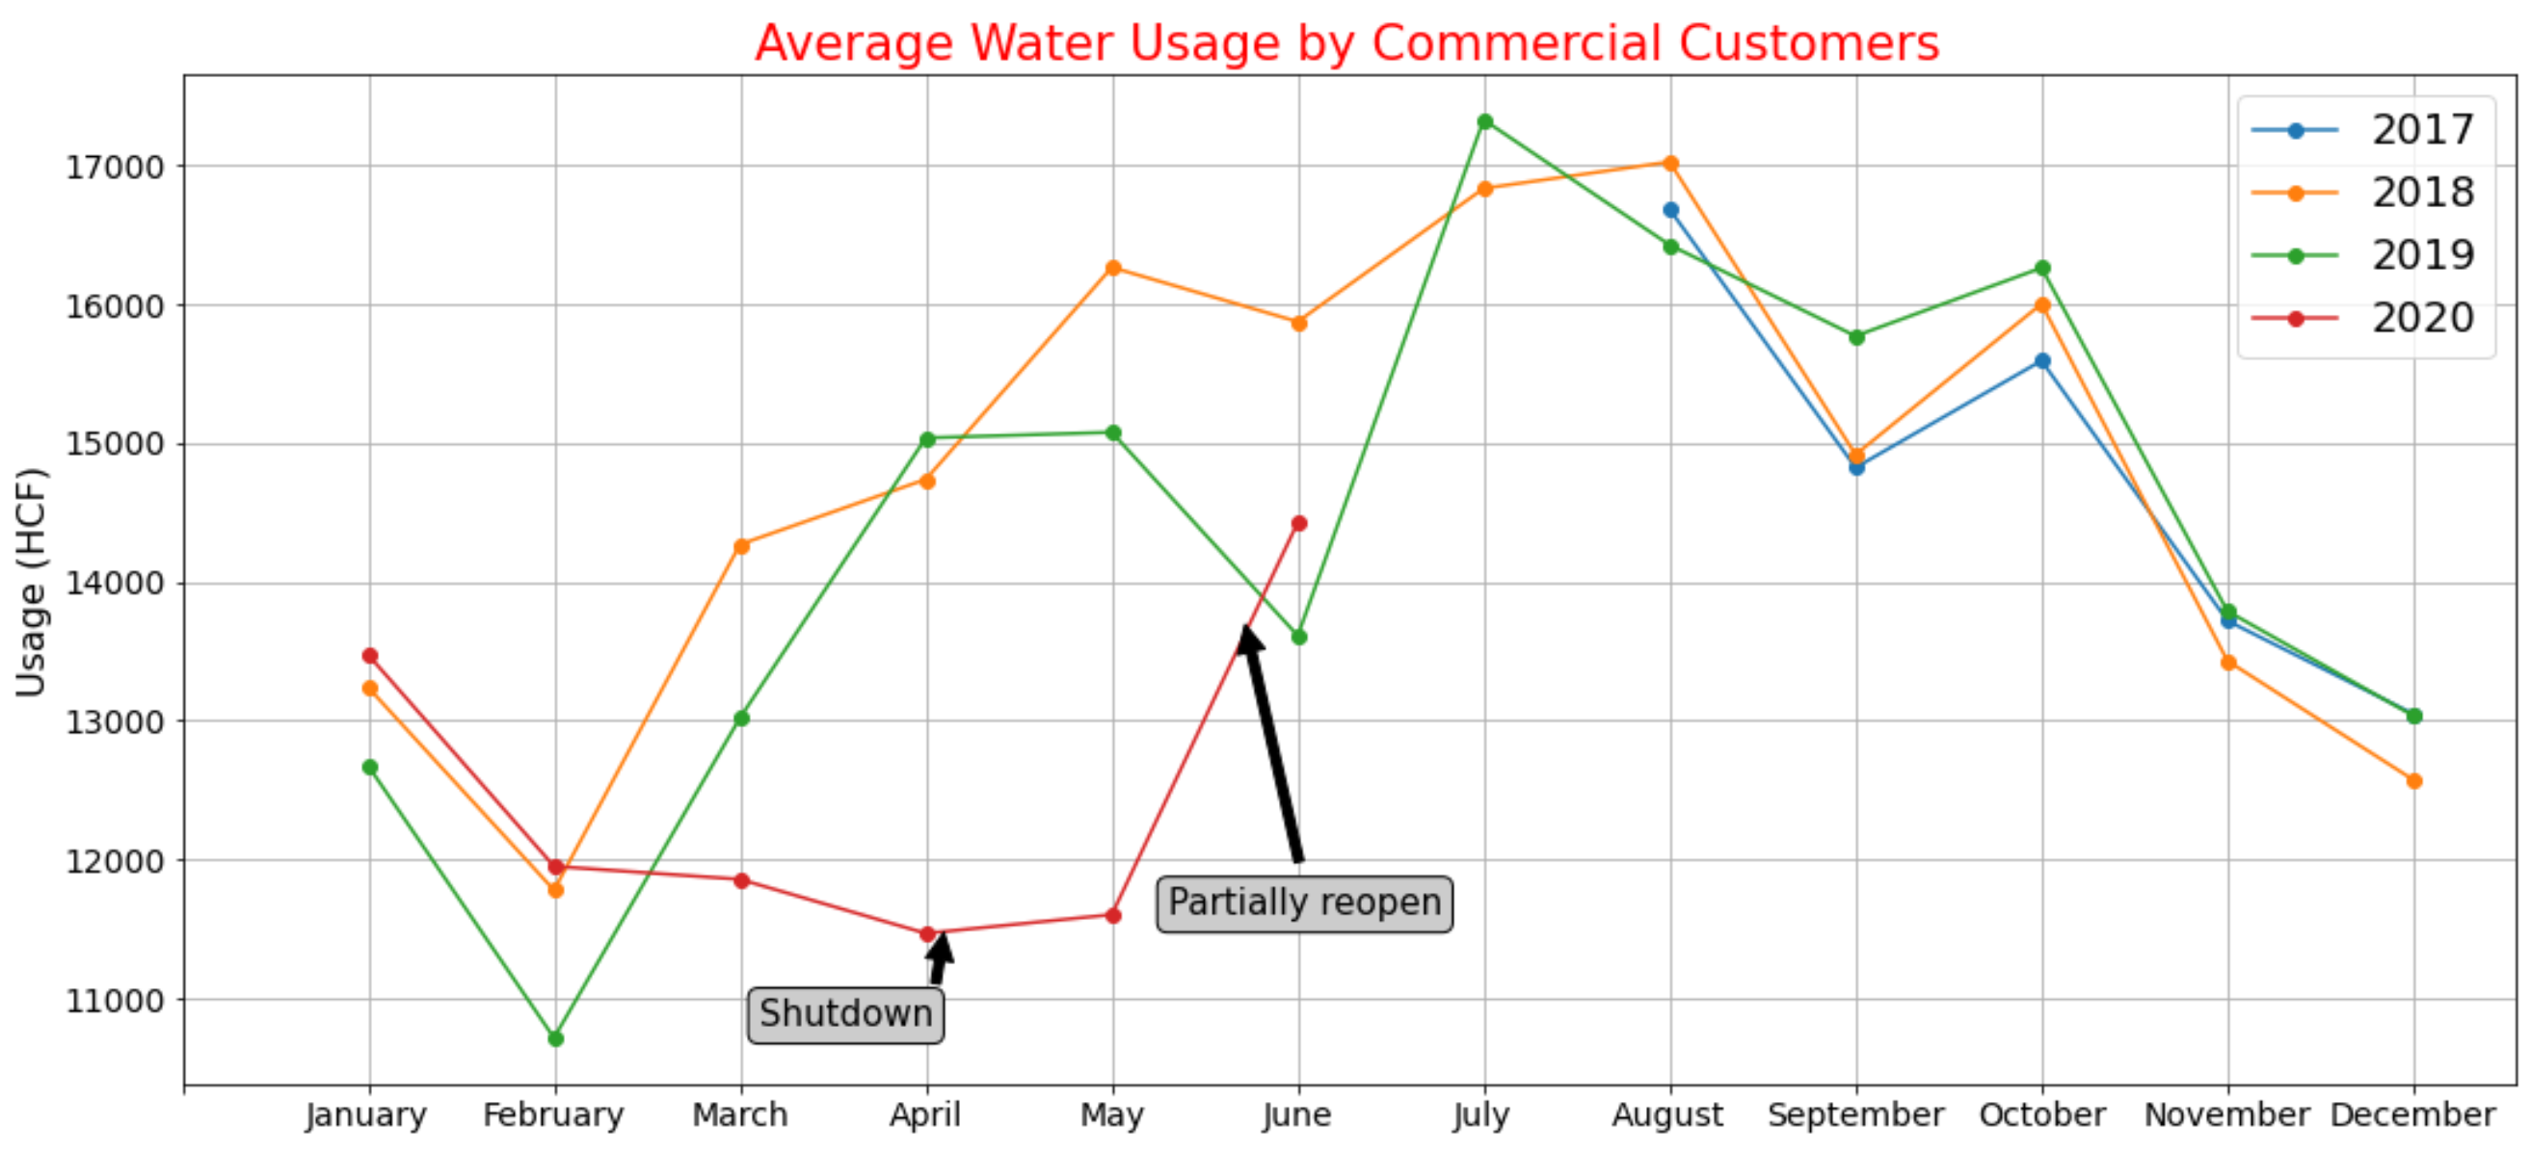
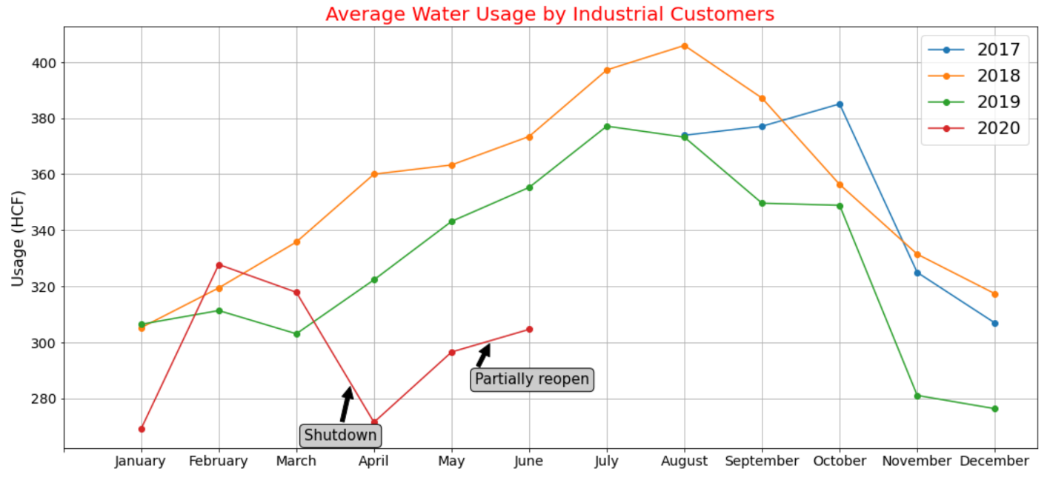
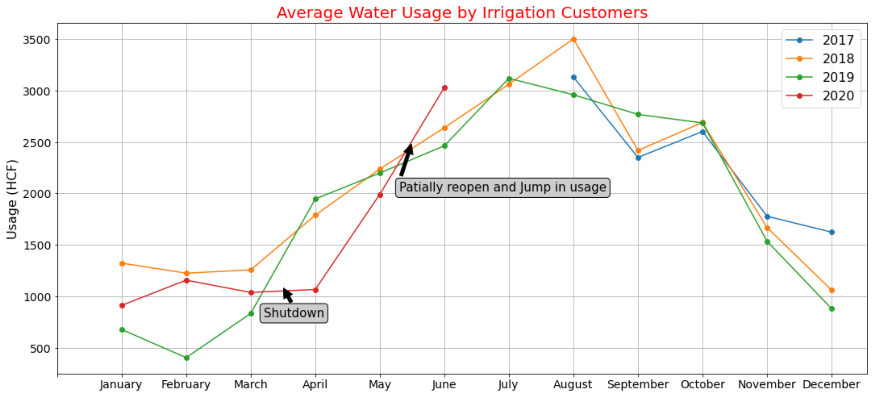
Shutdown and Decrease in non-Residential Segment in 2020
Shutdown and sharp drop in April and May
Reopen and usage jump in June

Slide 8
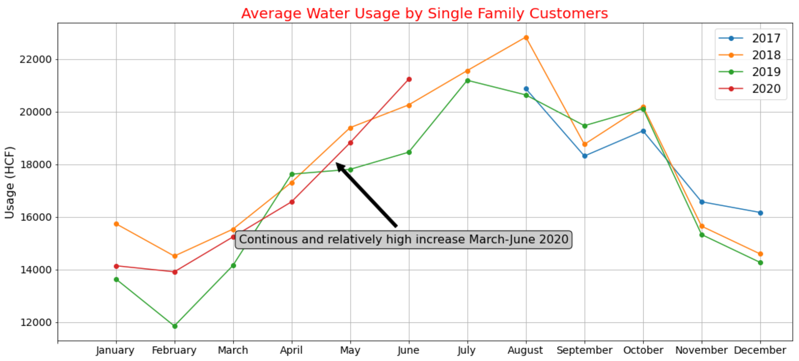
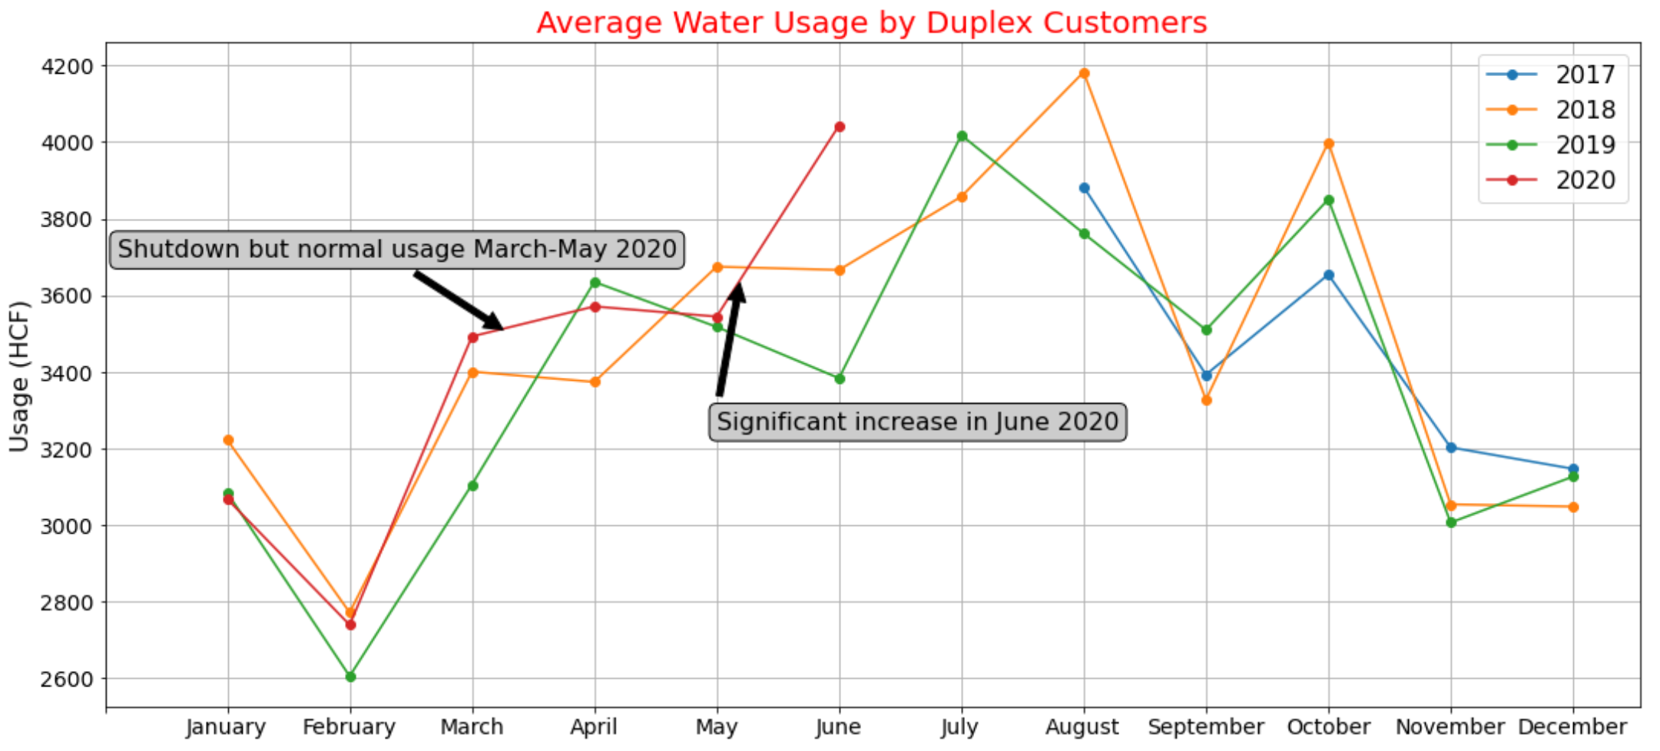
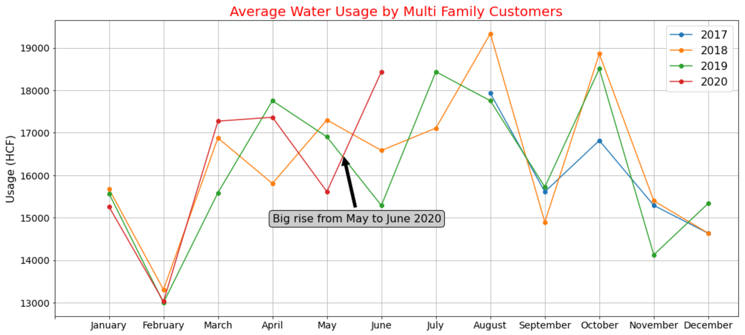
No Significant Decrease in Residential Usage in 2020
Single family kept its trend
Multi family and duplex:
Normal increase from March to May
Decrease in May
Grow in June

Slide 9
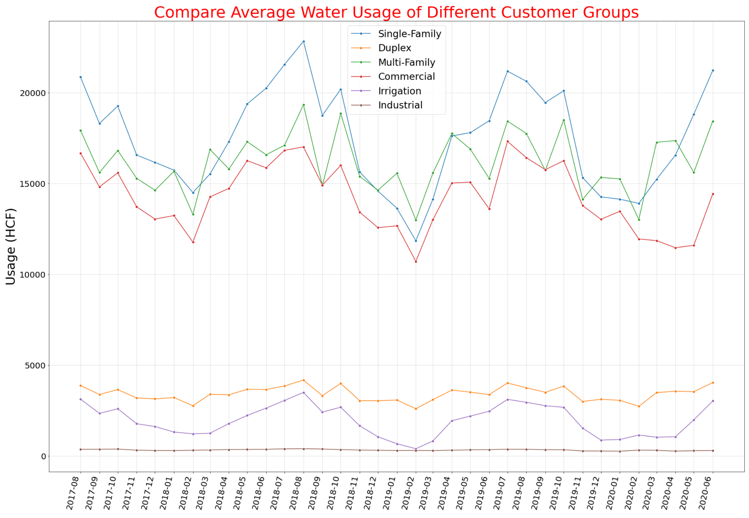
Single-Family and Multi-Family usage tried to offset the decrease in Commercial usage from March 2020

Slide 10
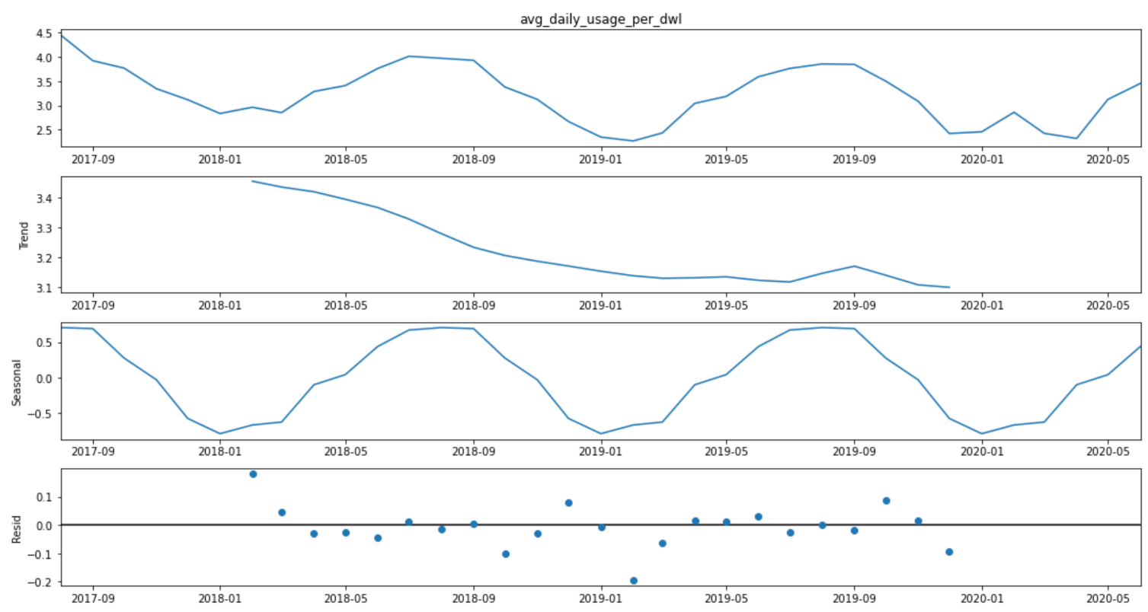
Non-Stationary Average Usage Time Series

Slide 11
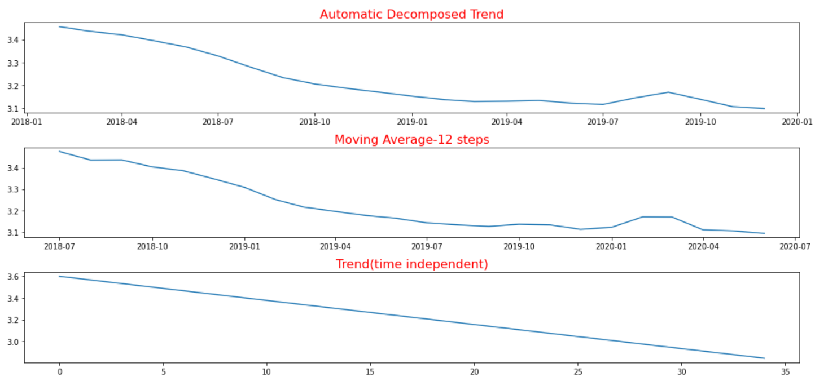
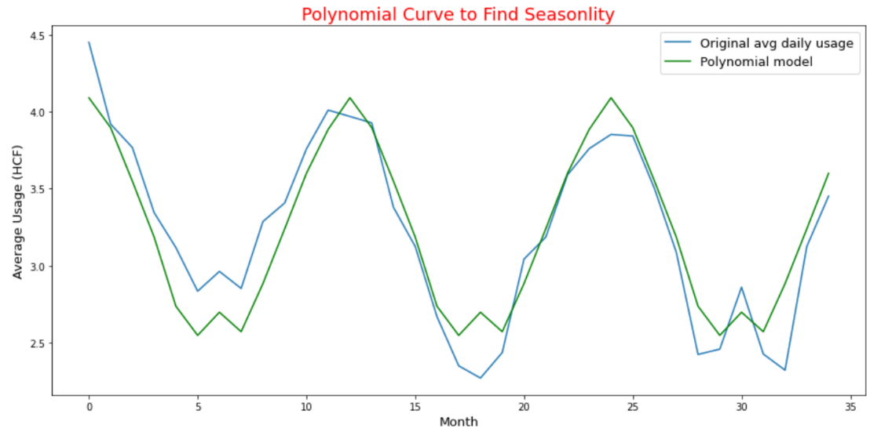
Automatic Decomposed Trend vs Time Independent Trend Time Independent Seasonality

Slide 12
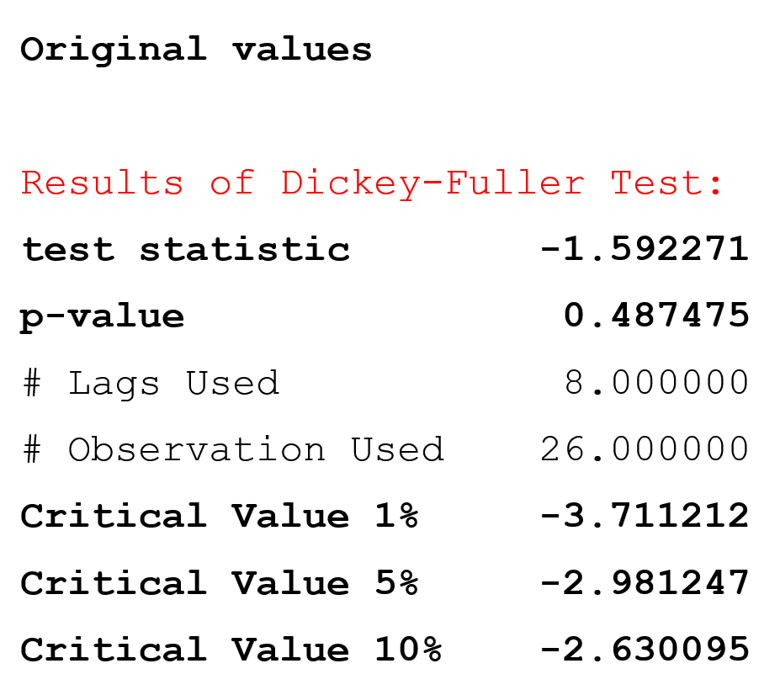
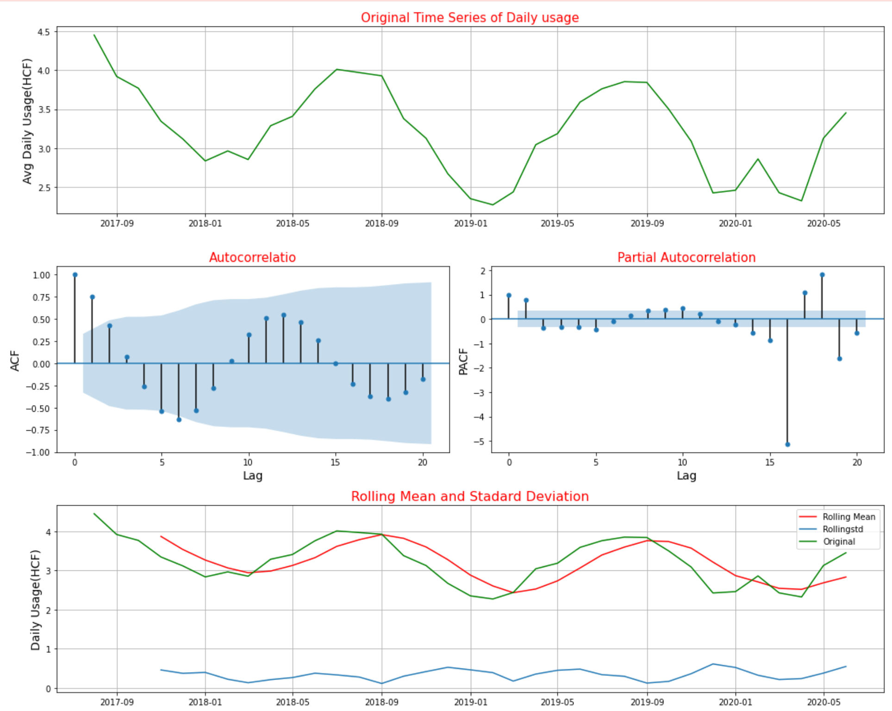
Non-Stationary Average Usage Time Series

Slide 13
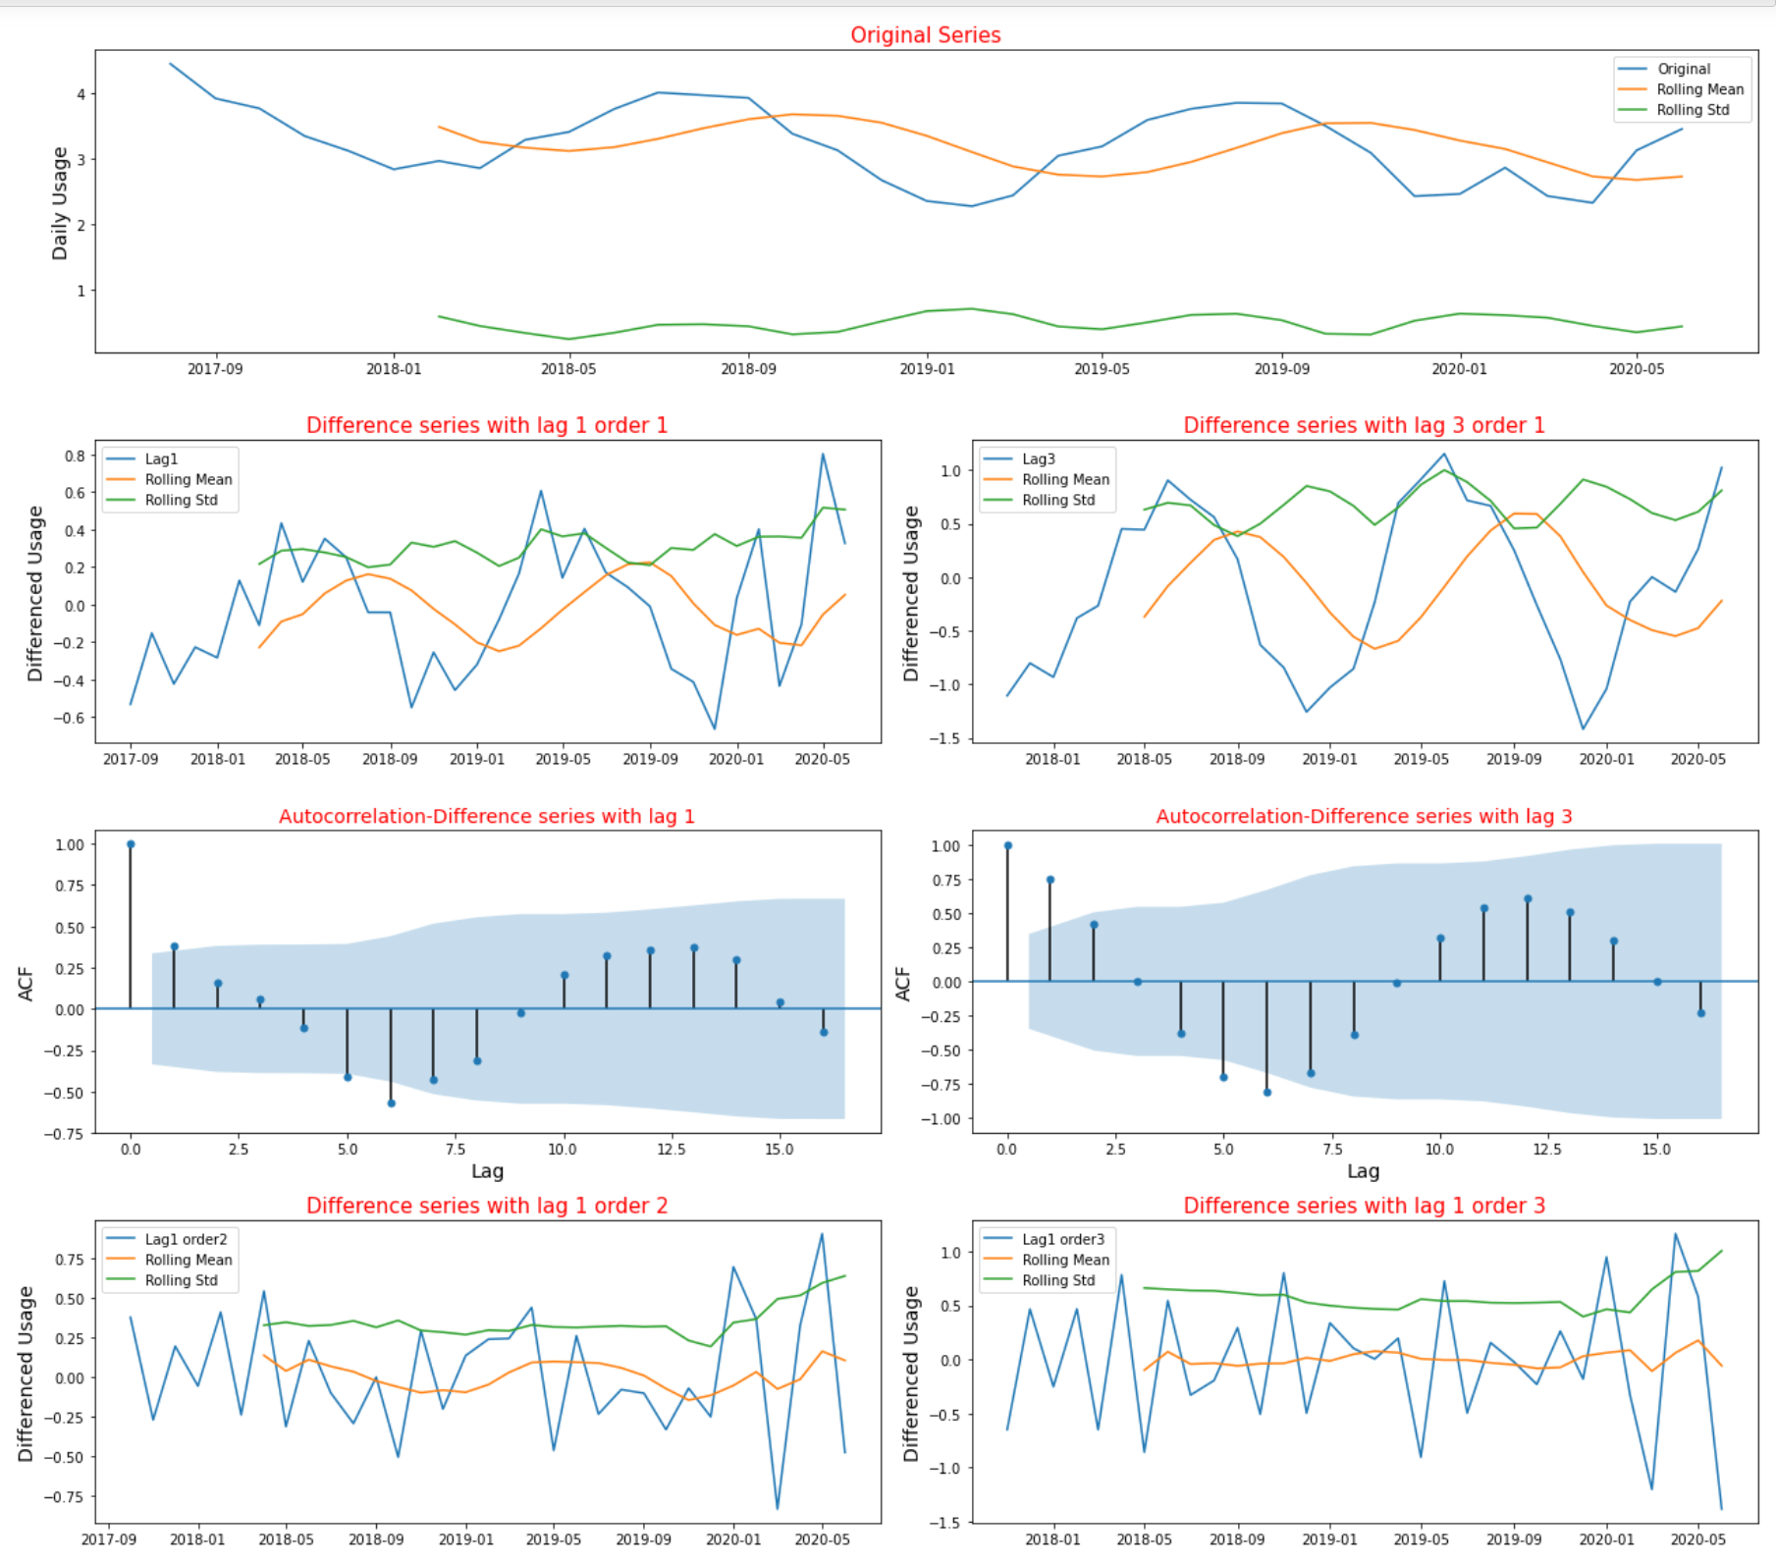
Make Time Series Stationary using Difference Transforming
Differenced series with lag 1 order 2 is stationary

Slide 14
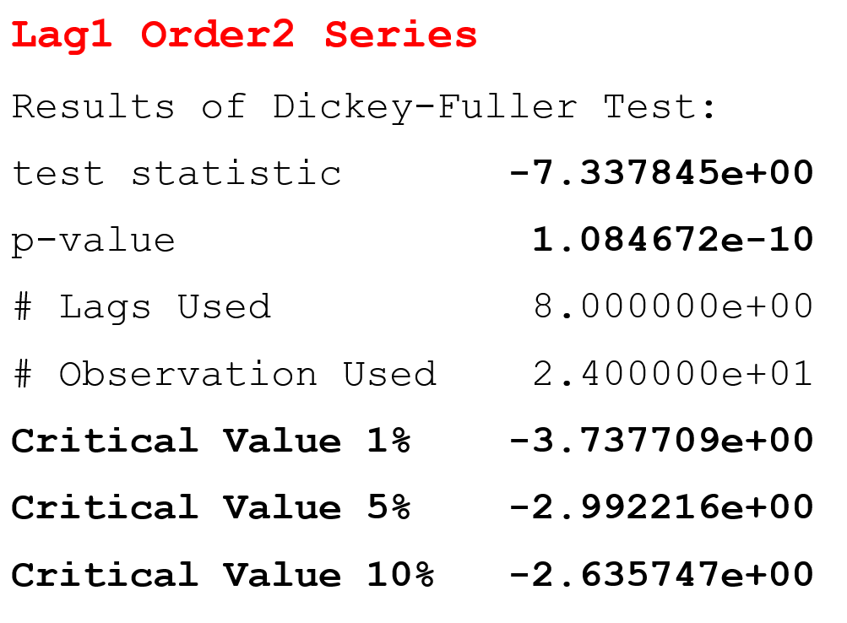
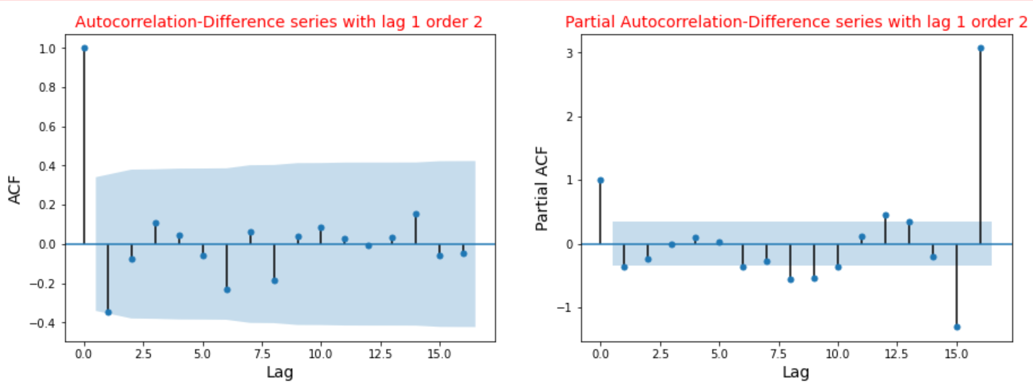
Stationary Differenced Series (lag 1 order 2)

Slide 15
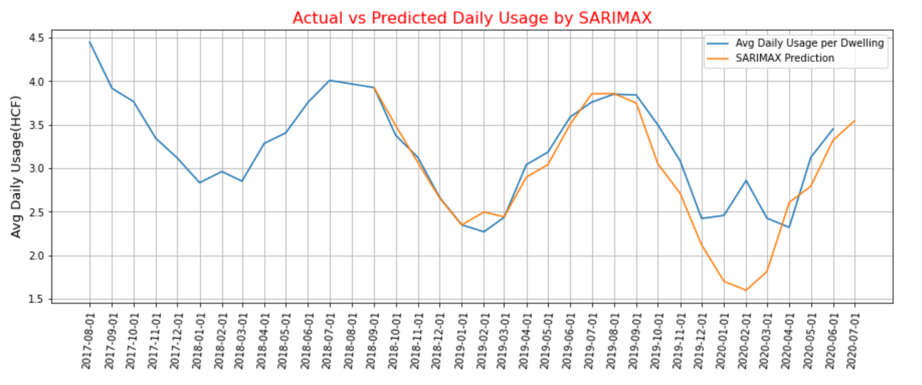
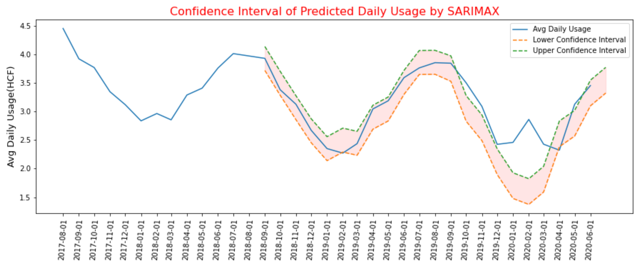
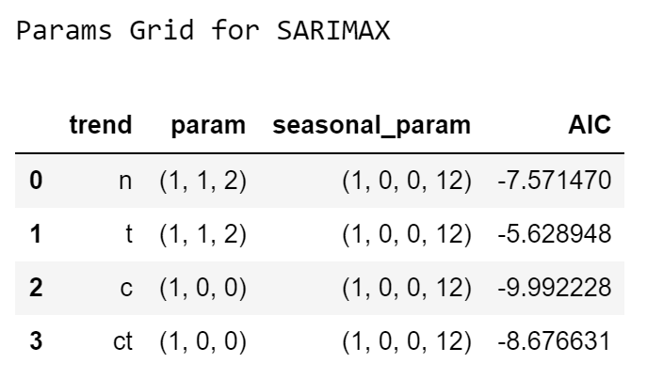
Prediction of SARIMAX

Slide 16
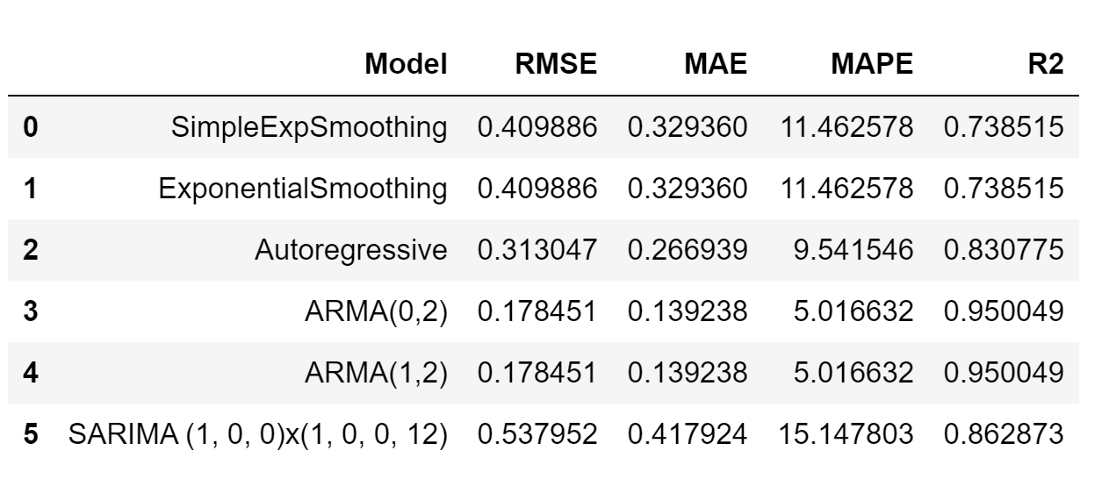
Performance of Univariant Time Forecasting Models

Slide 17
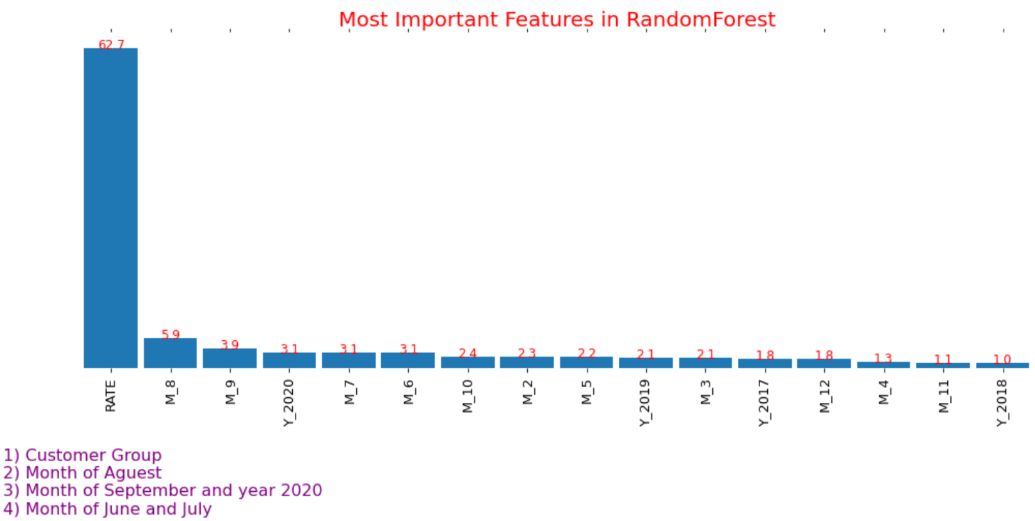
Importance Features

Slide 18
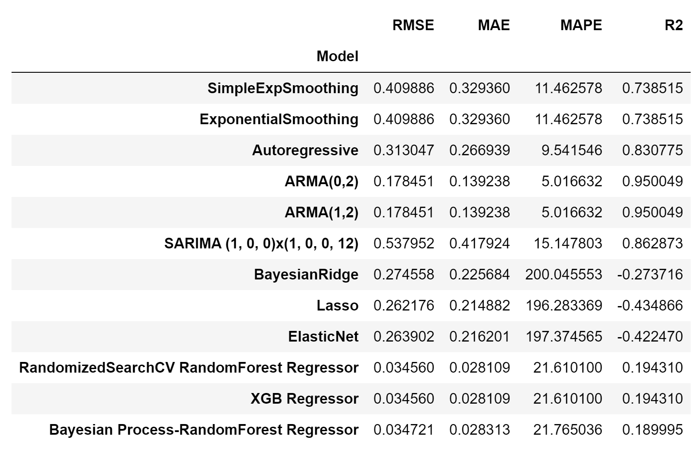
Compare Performance of Models Tested

Slide 19
Examples of the algorithm application

Slide 20

How Much Water Used in each Month? (based on the Records of Water Meter )
How many days elapsed? Read Days
How much usage is recorded since last meter read? Water Usage
Previous Read Date
Associated Read Date
Notes:
Read Date: Date that water meter was read to record water used since previous read date
Read Days:
Number of days that have elapsed between the associated read date and the previous read date.
Previous Read date:
Calculated from subtracting Read Days from Read Date
Water Usage:
How much water use was recorded since the last meter read (in hcf)

Slide 21
How Much Water Used in each Month?
How many days elapsed? Read Days: 55 days
How much usage is recorded since last meter read? Water Usage: 26 hcf
Previous Read Date
Mar 16, 2020
Associated Read Date
May 10, 2020
Which months are there between previous and associated read dates?
Month Start: Mar 1, 2020 | Month Start: Apr 1, 2020 | Month Start: May 1, 2020
Notes:
Read date: Date that water meter was read to record water used since previous read date

Slide 22
How Much Water Used in each Month?
How many days elapsed? Read Days: 55 days
How much usage is recorded since last meter read? Water Usage: 26 hcf
Previous Read Date
Mar 16, 2020
Associated Read Date
May 10, 2020
How many days should be counted in each month?
Month Start: Mar 1, 2020 | Month Start: Apr 1, 2020 | Month Start: May 1, 2020
Days to count: 16 | Days to count: 30 | Days to count: 9

Slide 23
How Much Water Used in each Month?
How many days elapsed? Read Days: 55 days
How much usage is recorded since last meter read? Water Usage: 26 hcf
Previous Read Date
Mar 16, 2020
Associated Read Date
May 10, 2020
How much usage should be counted in each month?
Month Start: Mar 1, 2020 | Month Start: Apr 1, 2020 | Month Start: May 1, 2020
Days to count: 16 | Days to count: 30 | Days to count: 9
Usage to count: (26/55)*16= 7.56 | Usage to count: 14.18 | Usage to count: 4.25
Notes:
Read date: Date that water meter was read to record water used since previous read date

Slide 24
How Much Water Used in each Month?
How many days elapsed? Read Days: 55 days
How much usage is recorded since last meter read? Water Usage: 26 hcf
Previous Read Date
Mar 16, 2020
Associated Read Date
May 10, 2020
Month Start: Mar 1, 2020 | Month Start: Apr 1, 2020 | Month Start: May 1, 2020
Days to count in March: 16 | Days to count in April: 30 | Days to count in May: 9
Usage to count in March: 7.56 | Usage to count in April: 14.18 | Usage to count in May: 4.25
Algorithm
Notes:
Usage to count in March: (26/55)*16= 7.56

Slide 25
Days in March = 31
Month Start Mar 1,2020 | Previous Read Date March 16, 2020 | Month End | Read Date May 10, 2020
 | previous_read_date_to_month_end 16 days
read_date_to_month_start 70
previous_read_date_to_month_end <= days in month (16 < = 31)
Month Start | days_to_count_in_period
2020-03-01 | 16
Days in April = 30
Month Start April 1, 2020 | Previous Read Date March 16, 2020 | Month End | Read Date May 10, 2020
 | previous_read_date_to_month_end 30-(-16) = 46 days
read_date_to_month_start 39
previous_read_date_to_month_end > days in month (46> 30) & read_date_to_month_start >= days in month (39 >= 30)
Month Start | days_to_count_in_period
2020-04-01 | 30
Days in May = 31
Month Start May 1, 2020 | Previous Read Date March 16, 2020 | Month End | Read Date May 10, 2020
 | previous_read_date_to_month_end 31-(-46) = 77 days
Read_date_to_month_start 9 days
previous_read_date_to_month_end < days in month (77 > 31) & read_date_to_month_start < days in month (9 < 30)
Month Start | days_to_count_in_period
2020-05-01 | 9

Slide 26
Days in March = 31
Month Start Mar 1,2020 | Previous Read Date March 16, 2020 | Month End | Read Date May 1, 2020
 | previous_read_date_to_month_end 16 days
read_date_to_month_start 56
previous_read_date_to_month_end <= days in month then (16 < = 56)
Month Start | days_to_count_in_period
2020-03-01 | 16
Days in April = 30
Month Start April 1, 2020 | Previous Read Date March 16, 2020 | Month End | Read Date May 1, 2020
 | previous_read_date_to_month_end 30-(-16) = 46 days
read_date_to_month_start 30
previous_read_date_to_month_end > days in month (46> 30) & read_date_to_month_start >= days in month (30 >= 30)
Month Start | days_to_count_in_period
2020-04-01 | 30
Days in May = 31
Month Start May 1, 2020 | Previous Read Date March 16, 2020 | Month End | Read Date May 1, 2020
 | previous_read_date_to_month_end 31-(-46) = 77 days
Read_date_to_month_start 0 days
previous_read_date_to_month_end < days in month (77 > 31) & read_date_to_month_start < days in month (9 < 30)
Month Start | days_to_count_in_period
2020-05-01 | 0

